Slide 1
Exploring Mobile Development
[ speaker name]
[ speaker contact methods ]
Notes:
Put your details above.
Each slide contains example script in the notes. Once confident with the content, you can use the headings in the notes as cues to ad-lib the content in your own words.

Slide 2
Mobile Development
Windows
Android
iOS
C#
Visual Studio
Java
Android Studio
Objective-C
Xcode
Source control
Source control
Source control
Build system
Build system
Build system
Testing
Testing
Testing
Monitoring
Monitoring
Monitoring
Notes:
CLICK Platforms
On tables, phones and other emerging mobile devices, development happens across multiple operating systems reaching billions of devices. In many companies this involves multiple teams working on different codebases. If they’re lucky they may at least be talking to a common backend with a common protocol. On the plus side, each team may be able to create a great experience on each platform because each platform has its own set of platform capabilities and UI framework that they are using to maximum effect.
CLICK Toolsets & Languages
These teams may be using different languages and tools, so hiring for those teams means hiring for different skillsets. Additionally testers and development managers must span those skillsets and tools.
CLICK Source control
It’s quite possible (especially when outsourcing) that the teams have evolved using their own source control systems or repositories, and there could be multiple codebases to be maintained.
CLICK Build system
Different build systems may be in place for testing, continuous integration and deployment.
CLICK Testing
Testing and automated testing frameworks may also be different.
CLICK Monitoring
Crash and usage monitoring are features that are increasingly valuable in creating and retaining user engagement where data should be aggregated.

Slide 3
A Better Model for Development
Windows
Android
iOS
One Language
One Toolset
Native API/Perf
Native UI/Perf
Single UI Framework
Source control
Build system
Testing
Monitoring
Notes:
CLICK - One Language/Toolset
If we can move core development into a common language we can leverage existing skillsets. With a common framework or core API surface we can also leverage the libraries that others have built. Having a single powerful and extensible toolset means we can leverage its capabilities to develop for all platforms.
CLICK - Native API/Perf
Along with a common language and core framework classes, such as Math and data manipulation, we also need access to the underlying platform APIs. We can’t be cutting corners on that access. It’s not good enough to have a lowest common denominator. When we call these APIs, the calling code still needs to possess native platform performance.
CLICK - Native UI/Perf
We need a way to use the UI framework & flow of each platform and that means having direct access to the UI framework and UI design surfaces that make sense to developers of each platform.
CLICK - Single UI Framework
There’s still some effort involved building separate UIs for each platform. UWP possesses a single framework across all Windows devices, and UI work on iOS spans phone and tablets. If we can have a common UI design system we could potentially save on resources and gain productivity across all these platforms. In doing this however, we’d still want to get native performance.
CLICK - Source control
With these things, we can hopefully share some code and that means a move towards a single repository.
CLICK - Build system
Building will still need SDKS and tooling for each platform, so any automated build system must be able to work with those.
CLICK - Testing
If we combine our development into one toolset that means we need a way to test apps on real devices or at least emulators during development with tools on our preferred development platform, and ideally a way to perform automated UI testing.
CLICK - Monitoring
We really want a single SDK for monitoring applications and a single repository to capture and report on that data.

Slide 4
Demo
A Multi-headed Application
Notes:
Example Script:
Let’s get started on the road to cross-platform development with a simple multi-headed sample application that shares a cloud-based backend, shares client-based business logic and has shared UI that we can run on UWP, iOS & Android.

Slide 5
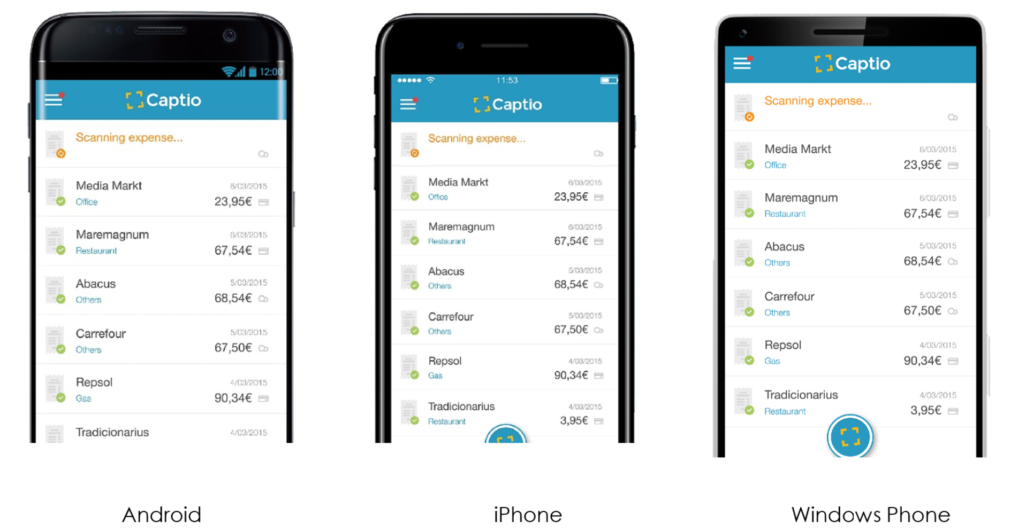
Captio for expense reports
First built with a native wrapped web-based solution but not happy with performance
So developed 3 native apps
Then to Xamarin Native to share business logic code
Later moved to Xamarin.Forms to also share UI.
Notes:
Now let’s talk about a real application which improved to Xamarin – Captio, and expense report application.
CLICK – Wrapped web not performant
Their first version of the app worked across Windows, iOS and Android platforms but they were not happy with the performance.
CLICK – 3 native apps
They then developed 3 different native apps. This was more performant but then required the maintenance of 3 separate code bases.
CLICK – Xamarin Native with shared business logic
The made the move to Xamarin and create shared business logic, reducing the maintenance burden
CLICK – Xamarin.Forms to also get shared UI
Finally they moved to Xamarin Forms, allowing them to create a shared UI looking almost identical on all platforms.

Slide 6
Write-once options
Contenders
Issues
App Generators
Web-based Solutions
Limited API Access
Slow Performance
Poor User Experience
Notes:
Let’s quickly address alternative methods for bringing applications to multiple platforms.
CLICK - App Generators
Using web sites or tools, there are solutions to create some classes of application, producing project files or deployable packages across multiple platforms.
CLICK - Web-based Solutions
Cross-platform applications can be delivered directly from the web, but typically with limited platform API access and performance. There are tools available to wrap website access and provide increased API access.
CLICK - Limited API Access
Some API access is achievable, but full access requires a fully native application.
CLICK – Slow Performance
Without native execution it’s difficult to achieve maximum performance on devices.
CLICK – Poor User Experience
Overall, along with a general need to be connected in the case of web-based solutions, this doesn’t provide a great experience for users.

Slide 7
Towards a Better Development Model…
Windows
Android
iOS
One Language
One Toolset
Notes:
So let’s build up a potentially better model for cross-platform mobile development.
CLICK – One language/toolset
Let’s look at getting one language and toolset, along with the benefits that may bring.

Slide 8
C#/.NET Build Across Platforms
.NET + C# + Bindings
Compile & Link
..APK
IL + JIT = Native
Android
.NET + C# + Bindings
AoT
.APP
Native ARM Binary
iOS
.NET + C# + Bindings
Native Compile
.APPX
Native ARM/x86/x64 Binary
Windows
Notes:
With C#, used on over 2.6 billion devices, along core classes and access to platform UI, we can find a path to building for all platforms using the right tooling.
CLICK – Windows
For UWP, code is compiled in the cloud and made available for different CPU architectures through the Windows Store as .APPX packages.
CLICK – iOS
On iOS, C# code in compiled Ahead of Time, distributed as a .APP package and runs natively on Apple’s ARM-based devices.
CLICK – Android
With Android, C# compilation and linking results in a .APK file whereby intermediate language code is compiled just in time to run natively on the device.

Slide 9
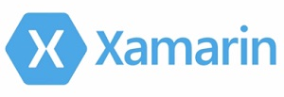
Tooling
Visual Studio
Xamarin Studio
Visual Studio for Mac ^{PREVIEW}
Visual Studio 2017 RC
Notes:
Now onto tooling…
CLICK – Visual Studio IDE
The Visual Studio IDE (including the free community edition) now provides the Xamarin toolset to build cross-platform applications for UWP, iOS, Android, Tizen, WPF and more. This extends to Hyper-V based emulators for Windows 10 Mobile and Android emulators, as well as remote iOS simulator access. It integrates with many of the DevOps feature we would like to have.
CLICK – Visual Studio 2017 RC
This new version of the tool will bring increased productivity and integration with DevOps practices.
CLICK - Xamarin Studio
This existing tool allows for Xamarin development on a Mac
CLICK – Visual Studio for Mac Preview
.... It is being replaced by Visual Studio for Mac, currently in preview, raising the level of productivity features and better integration of DevOps practices. It allows for targeting iOS, Android, macOS and wearables.
FUTURE
Upcoming tooling brings in features like the Xamarin inspector for live visual interrogation of running apps and the ability to make live changes.

Slide 10
Towards a Better Development Model…
Windows
Android
iOS
One Language
One Toolset
Native API/Perf
Notes:
So let’s keep pursuing a better model…
CLICK – Native API/Perf
Now we are looking at getting access to the native APIs on each platform to retain top performance.

Slide 11
Platform Access with Xamarin
Android
Text-to-speech
ActionBar
Printing Framework
Renderscript
NFC
iOS
MapKit
UIKit
iBeacon
CoreGraphics
CoreMotion
Windows
Microsoft.Phone
Microsoft.Networking
Windows.Storage
Windows.Foundation
Microsoft.Devices
System.Net
System
System.IO
System.Linq
System.Xml
System.Data
System.Windows
System.Numerics
System.Core
System.ServiceModel
Notes:
Here’s a base set of libraries made available as .NET classes through Xamarin on all platforms.
Nuget Packages
If all platforms have a common minimum service available then libraries written by others can be leveraged across all platform and sourced as Nuget packages
Future
This model isn’t perfect because the iteration of C# and the .NET classes provided are not up to date. .NET Standard 2.0 represents a possible future where an increased surface area may become available across a large number of devices.
On top of this we add access to platform-specific APIs.
CLICK – Windows
Here’s a set of clearly Microsoft-centric APIs which are available.
CLICK – iOS
Equally, there are iOS features available. Specifically there is 100% coverage.
CLICK – Android
Also with Android, you’ll get 100% access.
CLICK – All
Anything you can do in Objective-C, Swift, or Java can be done from C# through Xamarin.
Tizen OS
Samsung has announced a preview of its tools using this approach which will open up C#/.NET development of 10s millions of additional devices.

Slide 12
Towards a Better Development Model…
Windows
Android
iOS
One Language
One Toolset
Native API/Perf
Native UI/Perf
Notes:
So we can target all these platforms
CLICK – Native UI/Perf
An important part of platforms is the UI. Developers need to feel comfortable with building UI and not being ripped away from systems they use.

Slide 13
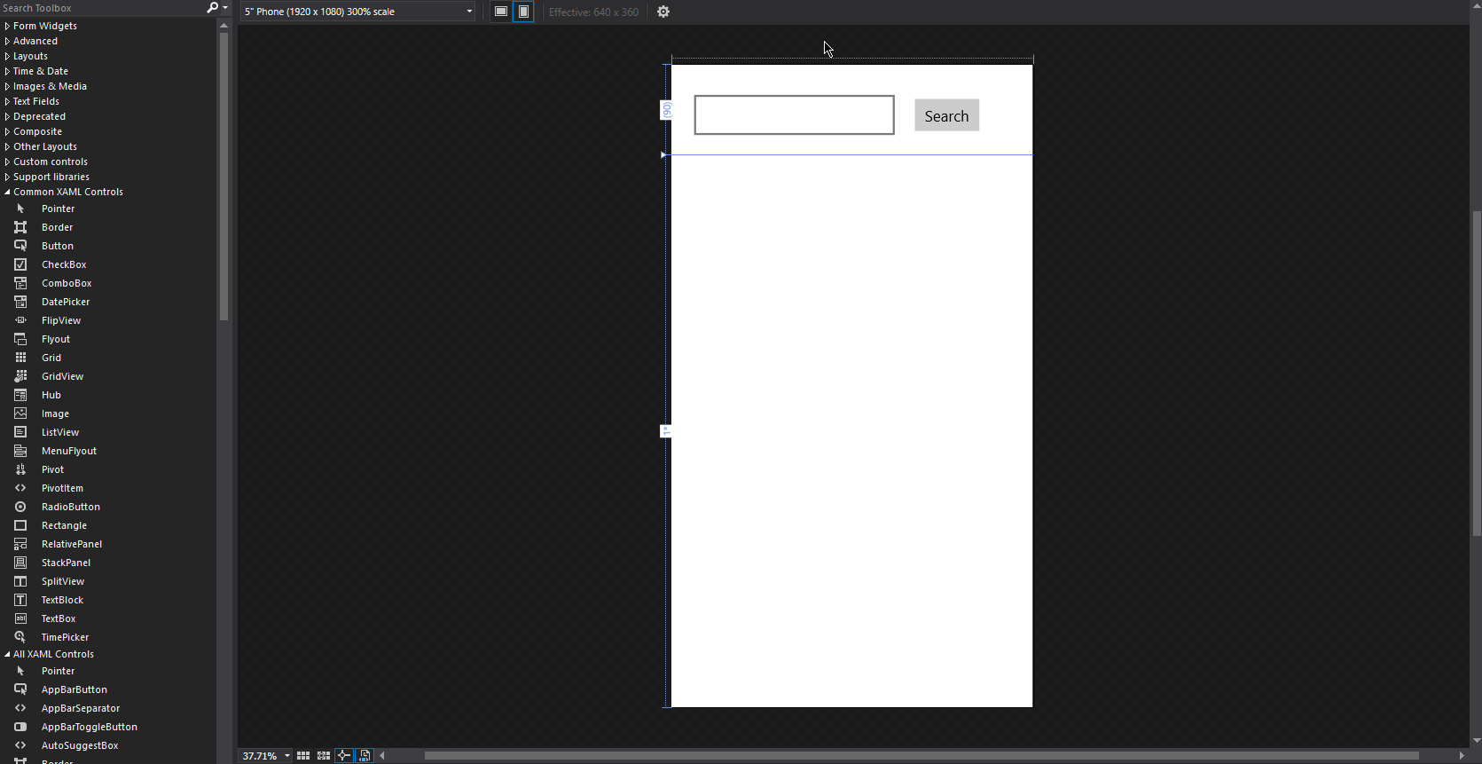
UWP Design Surface
Notes:
The UWP designer is of course readily available in Visual Studio, with all the controls and tooling you would expect.

Slide 14
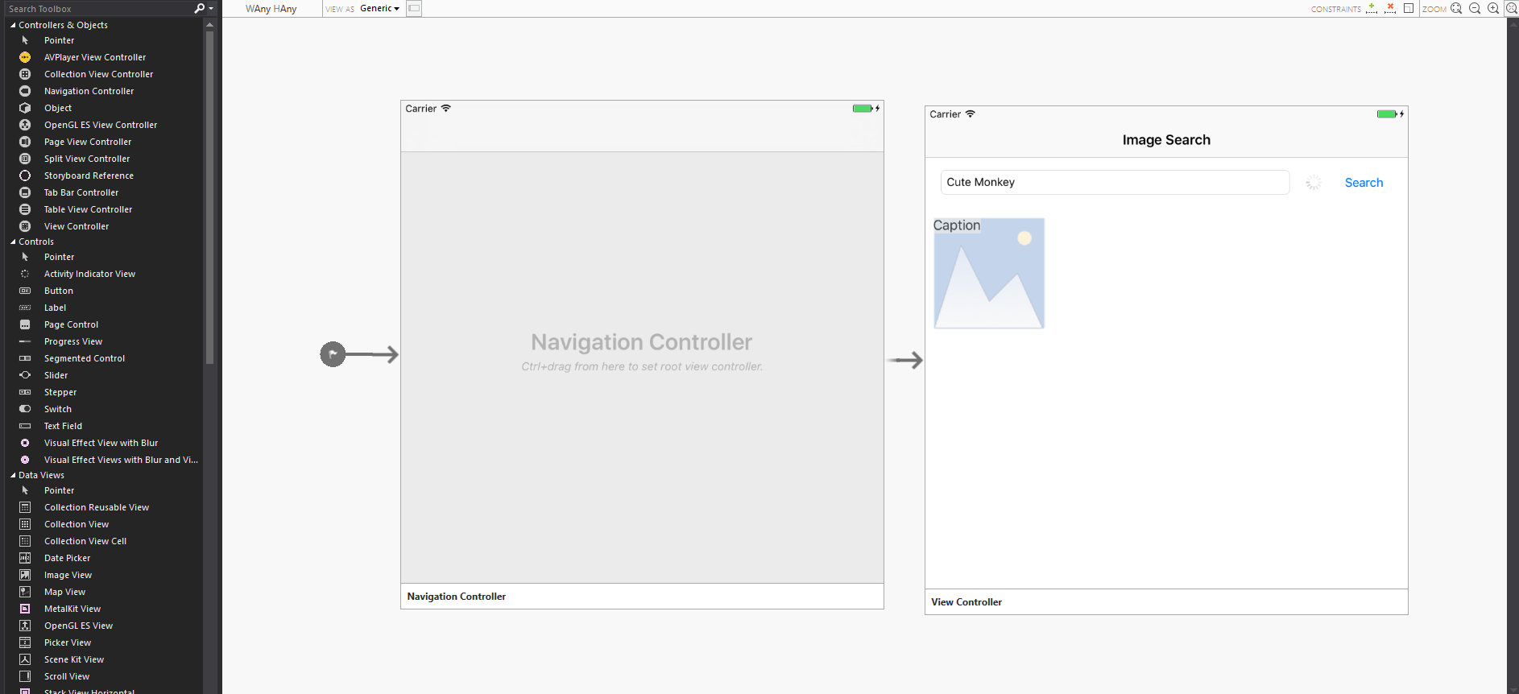
iOS Design Surface
Notes:
Not surprisingly, there’s also an iOS design surface. This is available directly on a MAC, and also on Visual Studio on Windows through a remoting experience. It supports all UIKit elements, editing of custom and 3rd party components and live preview of property changes.

Slide 15
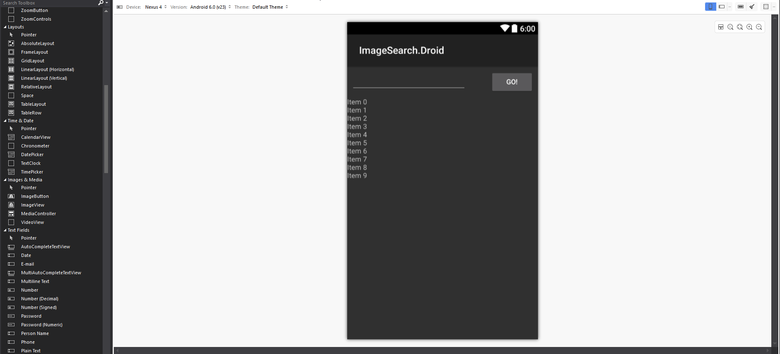
Android Design Surface
Notes:
The Android design surface is directly available in the tooling on both platforms. This includes design preview for different Android devices and Android versions.

Slide 16
Demo
New Platform on Shared Business Logic
Notes:
So let’s take a look at the situation where we already have an application on one platform and we want to share some code and extend to another platform. In this case, we are starting with a UWP project that already has some shareable code written in C#.

Slide 17
Towards a Better Development Model…
Windows
Android
iOS
One Language
One Toolset
Native API/Perf
Native UI/Perf
Single UI Framework
Notes:
So you saw how we can add an Android head to the existing UWP application and we used Android .axml files specific to that platform with its own UI. We also got to leverage some Nuget packages.
CLICK – Single UI Framework
Ideally, especially when starting on a new or greenfield development it would be great to create the UI once, to help keep features and UI branding in sync. In using a common UI framework, we want this to translate directly down to the native UI framework so we can maintain native performance.

Slide 18
Demo
Shared Business Logic & Shared UI
Notes:
Let’s reset back to that same existing UWP application and see what happen if, instead of adding native Android UI files, we use a common XML dialect with the XAML framework in Xamarin Forms.

Slide 19
Resolving Complexities
Native Code & Wrappers
Plug-ins
Custom Controls
Custom Renderers
Native Controls in Forms
Notes:
So we’ve just touched the surface on using Xamarin for common business logic, UI and accessing platform APIs. There are some things you may want to know in order do to make the transition to this model easier.
CLICK - Native Code & Wrappers
You may have native code that you aren’t ready or able to replace or re-write yet. You can call native code and use wrappers for when the OS needs to call back to your code.
CLICK - Plug-ins
Let’s say you want to access the camera on multiple platforms, rather than write conditional code that calls different APIs on each platform, you can get a plug-in that does that work for you and presents an abstraction so you don’t have to worry about the platform differences.
CLICK - Custom Controls
So get the controls you want on a platform may mean composing controls from other controls.
CLICK - Renderers
When a control on a platform isn’t available or you really want the UI to look consistent across platforms you’ll want to look at renders in Xamarin Forms.
CLICK - Native Controls in Forms
There’s now also the ability in Xamarin forms to include platform-specific control tags in the XAML that will be ignored in the other platforms.

Slide 20
Towards a Better Development Model…
Windows
Android
iOS
One Language
One Toolset
Native API/Perf
Native UI/Perf
Single UI Framework
Source control
Build system
Notes:
Moving on from the direct app development, we’ll now turn to DevOps.
CLICK – Source control & Build system
Now we have the possibility of a cross-platform application built in a single solution. This means we can use a single repository and look for features like automated builds, continuous integration and unit testing.

Slide 21
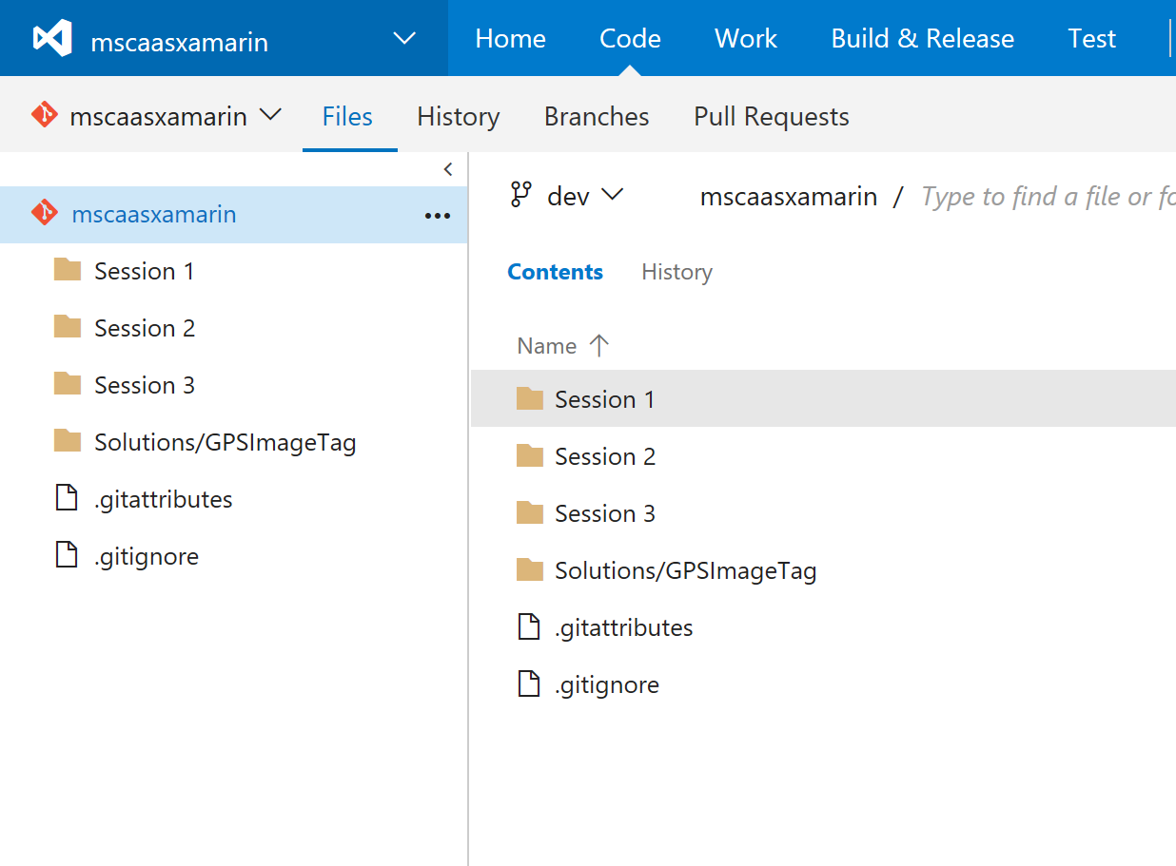
Source Control & Build
Visual Studio Team Services
Git Repository – unlimited private
Free for up to 5 users
Significant work item tracking including agile templates
Build platform for creating CI
Integrates test processes
Integration with GitHub and 3rd-party services at other stages.
Notes:
CLICK – Visual Studio Team Services
Visual Studio Team Services provides solutions for source control and build automation
CLICK – Git Repo
It acts as a Git Repo allowing use from all kinds of clients with an unlimited number of private repos
CLICK – Free for up to 5 users
It’s free for up to 5 basic users. MSDN subscribers can be added without taking up a license slot.
CLICK – Process templates
Work item tracking and reporting is a major feature including support for a variety of process templates including Agile templates supporting sprints, backlogs and burn-down charts.
CLICK – Build platform for CI
There’s a fully configurable build pipeline including the ability to create Continuous Integration with the running of Unit Tests.
CLICK – Integrate testing
As well as unit testing, other testing such as UI testing and user acceptance testing can be included.
CLICK – Integration
Source can come from GitHub; builds can be done with Jenkins. There are a number of 3rd-party integration points available.

Slide 22
Towards a Better Development Model…
Windows
Android
iOS
One Language
One Toolset
Native API/Perf
Native UI/Perf
Single UI Framework
Source control
Build system
Testing
Notes:
So we can create code, store it and build it…
CLICK – Testing
If we can build it, and in an automated way, then we likely also want to test it, including at the UI level… This needs to be able to test a broad range of devices, OS versions and models….

Slide 23
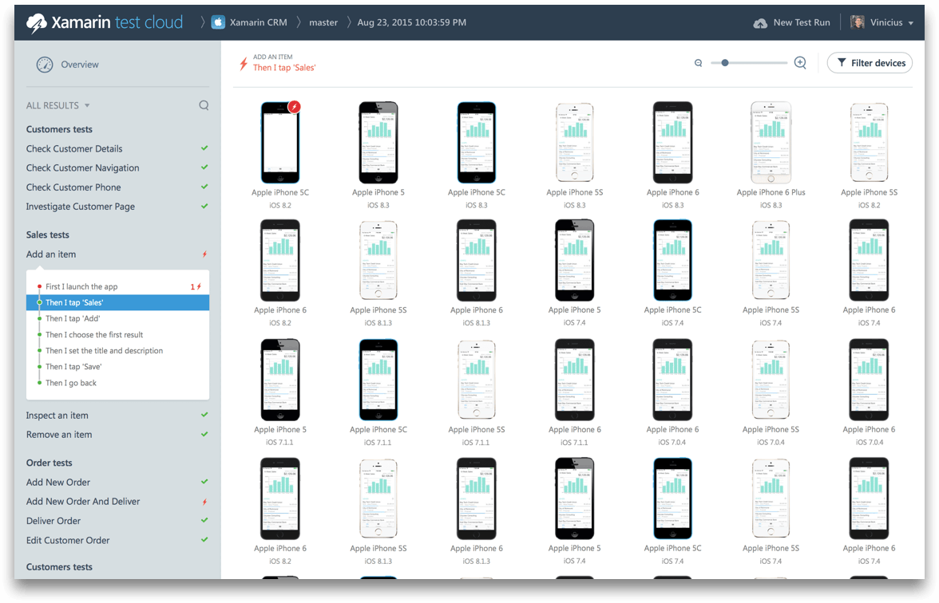
Testing
Xamarin Test Cloud
Test on over 2000 different devices
Simulate clicks; get screenshots; query UI
Write tests in C#, etc.
Integrate with CI
Examine individual or aggregate device results
Notes:
CLICK – Xamarin Test Cloud
Xamarin Test Cloud can form a crucial part of your test cycle
CLICK - 2000 devices
It can test over 2000 different devices with more models being added. You can even sort devices by market popularity.
CLICK - Simulate and collect
The system simulates clicks; collects screenshots and allows parts of the UI to be queried. A broad range of device features are available including GPS and camera.
CLICK - Test with C#
As well as other languages, the tests can be written in C#, extending the reach of the language.
CLICK – CI
Tests on Xamarin Test Cloud can be part of a CI setup so that tests are automatically run on new commits.
CLICK – Results
You can see details from individual devices or aggregate results that immediately show the state of play.

Slide 24
Towards a Better Development Model…
Windows
Android
iOS
One Language
One Toolset
Native API/Perf
Native UI/Perf
Single UI Framework
Source control
Build system
Testing
Monitoring
Notes:
So we’re really building up the DevOps practices
CLICK – Monitoring
To complete the cycle on DevOps, we need to get data back from running devices to enable us to troubleshoot issues and get feedback on application use….

Slide 25
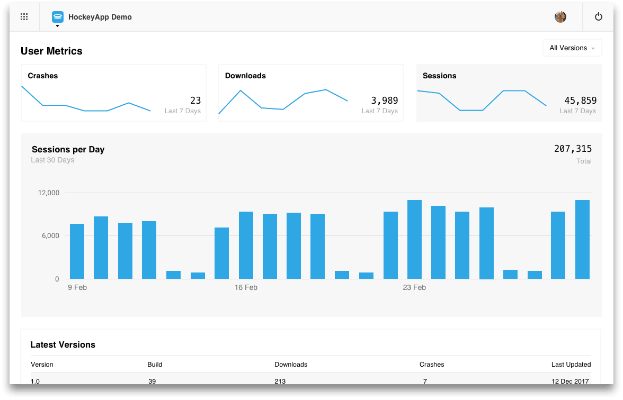
Monitoring
HockeyApp
Crash reports
App usage
Communicate with users
Notes:
CLICK – HockeyApp
HockeyApp is a popular cross-platform SDK and service used by many application developers allowing distribution and collaboration with testers along with analysis of real world use.
CLICK – Crash Reports
Get crash reports to analyze
CLICK – App usage
Use in the testing phase to see what testers are doing or later on to see how users are using your application.
CLICK – Communicate
Get feedback, support requests and bug reports from within your app.

Slide 26
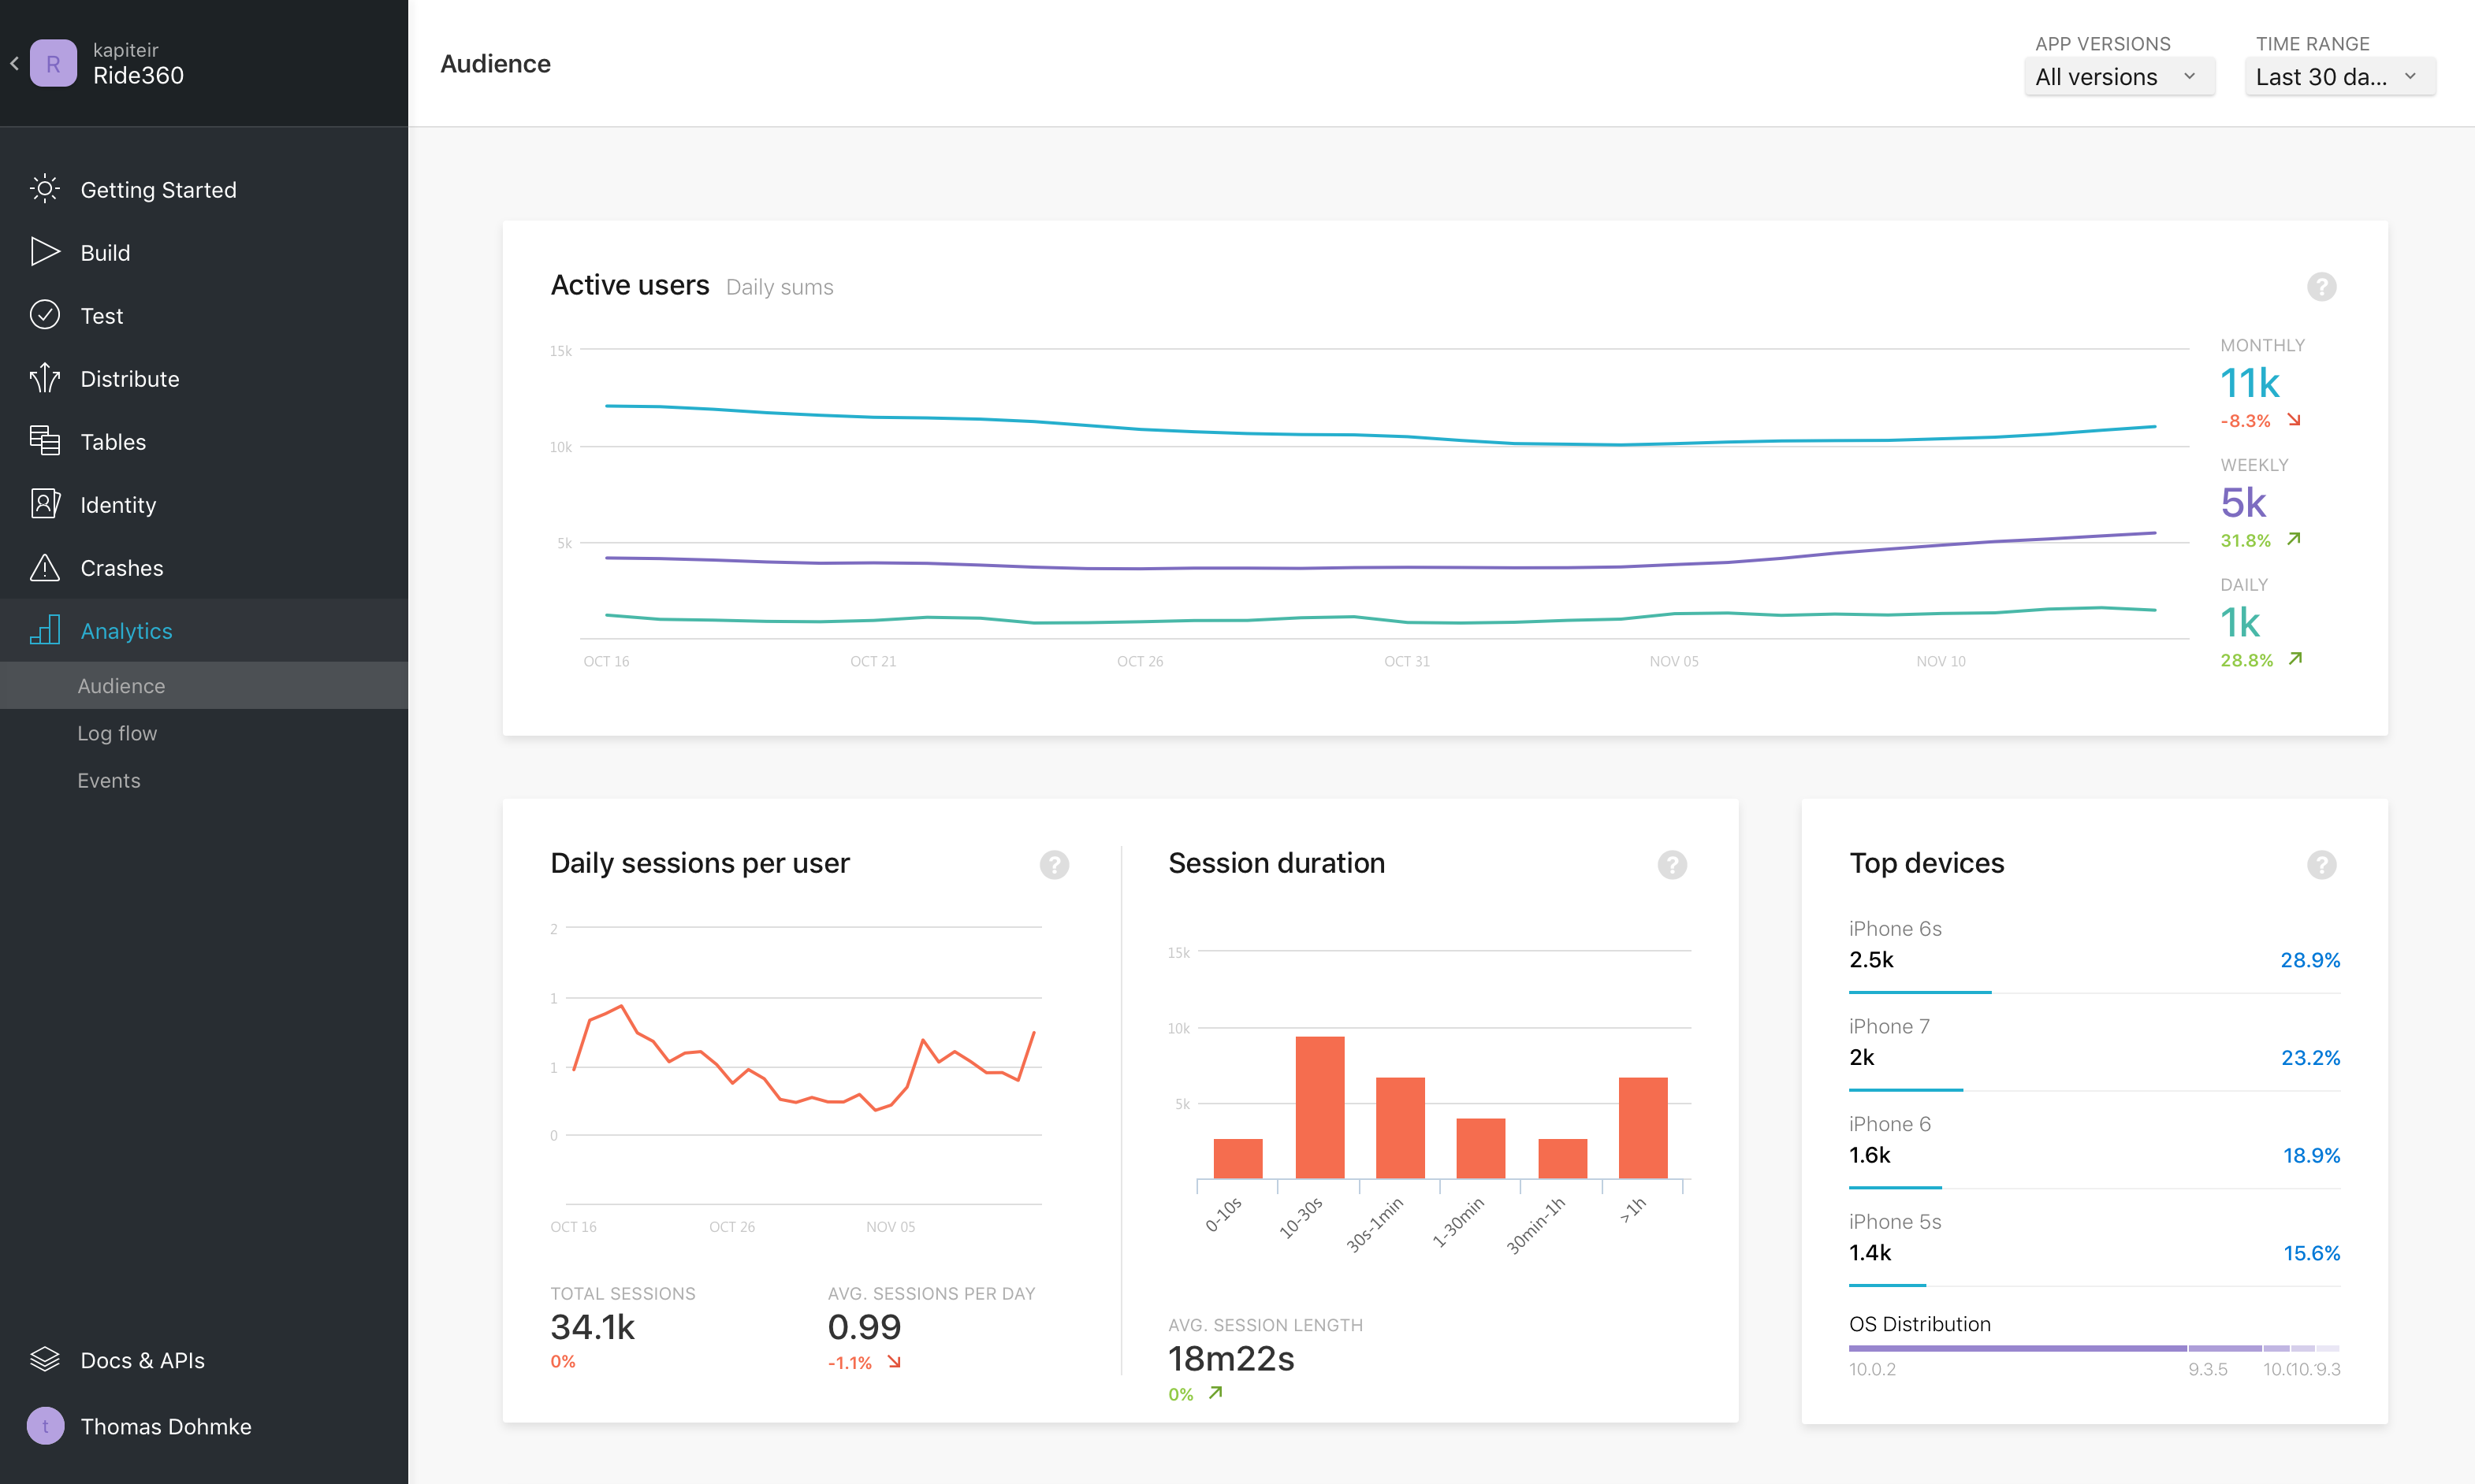
Visual Studio Mobile Center (Preview)
Notes:
These DevOps practices have been rolled up and are now available in a new portal called the Visual Studio Mobile Center.
This brings together Build, Test and Monitoring (with Crash collection & Analytics). It also helps manage distribution. It’s currently available in Preview and you can sign up to get an invite.

Slide 27
Demo
Automated UI Testing
Notes:
Finally, let’s look at one of those DevOps practices – UI Testing using the Xamarin Test Cloud. We’ll see what a UI test looks like and how we get that running in the cloud.

Slide 28
Resources
Further sessions in this series:
Starting Mobile Development – Xamarin building blocks around the image upload application – decisions and demos
Practical Mobile Development – consistent UI using Forms, incorporating DevOps, hands-on lab
Learn about Xamarin - https://www.xamarin.com/platform
Get started for free on Mac & PC - https://store.xamarin.com/
The Xamarin Show - https://channel9.msdn.com/Shows/XamarinShow
Xamarin University - https://www.xamarin.com/university
Notes:
As shown

